Slide 1
Georeferencing

Slide 2
Georeferencing

Slide 3
Introduction
Geo-referencing" is the process of assigning real-world geographic coordinates to data points within a dataset, essentially attaching a specific location on Earth to each piece of information, like an image, map, or sample, allowing it to be accurately positioned on a map; the principle behind it is to identify known reference points on the data and use mathematical transformations to link those points to their corresponding geographic coordinates, effectively "grounding" the data to the real world.
How geo-referencing works:
Identify control points:
Locate recognizable features on both the data (image, map, etc.) and a reference map that have known geographic coordinates.
Assign coordinates to control points:
Match the identified features on the data to their corresponding locations on the reference map, assigning their geographic coordinates.
Apply transformation:
Use the control points and mathematical equations to calculate the necessary transformations to convert all data points within the dataset to real-world coordinates.

Slide 4
Establish Registration Control Points
Select the type of transformation to be used on the image. Four transformations are available:
1. Conformal (Minimum of 2 control points);
2. Affine (Minimum of 3 control points);
3. 2nd Order Polynomial (Minimum of 6 control points);
4. 3rd Order Polynomial (Minimum of 11 control points).

Slide 5
Four image transformation techniques are available for selection by the user, however to achieve the best results the correct transformation type should be used for the type of raster image selected.
Conformal Transformation: This transformation method requires a minimum of 2 control points. The conformal transformation should only be used where the original raster image is based upon an orthogonal map grid with minimal distortion.
Affine Transformation: This transformation method requires a minimum of 3 control points. The affine transformation is best used where the original raster image is based upon an orthogonal map grid which may have systematic scale and axis rotation distortion. It can also be used effectively where the original raster image is based upon a latitude / longitude grid or on orthophoto map images.
2nd Order Polynomial Transformation: This transformation method requires a minimum of 6 control points. Polynomial transformations should be used where the original raster image has distortions other than just uniform scale distortions in the x and y directions and a rotation distortion between the x and y axes. Polynomial transformations are best used on aerial photographs with minimal elevation differences across the image.
3rd Order Polynomial Transformation: This transformation method requires a minimum of 11 control points. The third order polynomial transformation can be used where more control points are available to achieve a better determination of the distortions.

Slide 6
Methodology
Pre-requisite
Add Geo-referencing and Editor tool ribbon to Arcmap toolbar menu
Activate Co-ordinate projection in WGS 1984

Slide 7
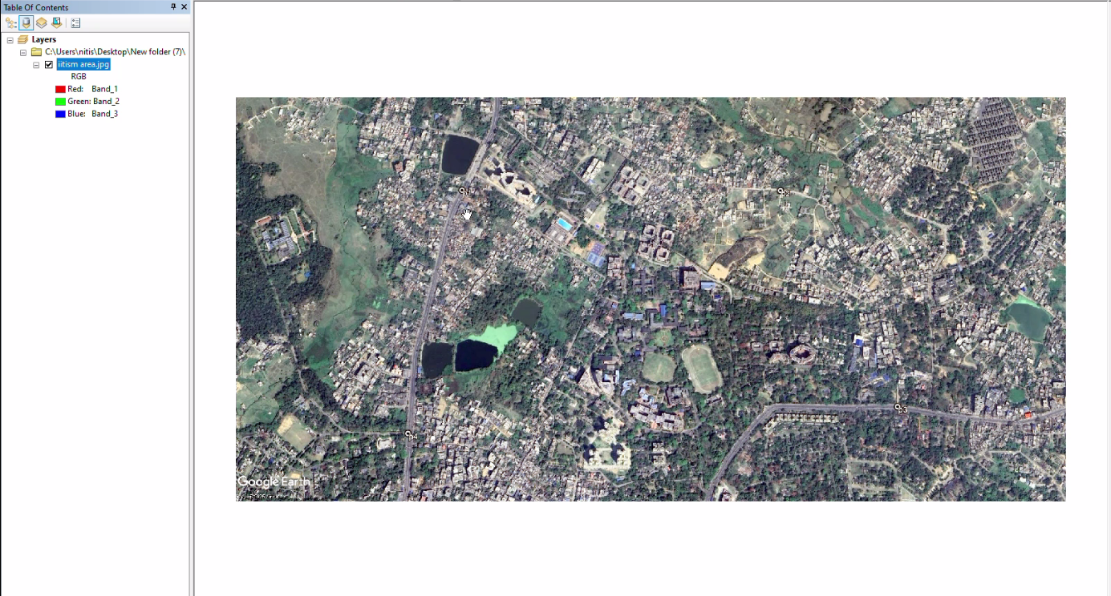
Methodology
Step1:calling google earth image product to arcmap window
Left click on Add data Icon then create a folder connection to the product folder.
Here, image is not georeferenced, You can identify this by the coordinates displayed in the bottom corner.

Slide 8
Methodology
Note:
Change the projection to GCS to convert the coordinate system from decimal degrees to degrees, minutes, and seconds.
Minimum 4 control point need to be georeferenced and check for RMS error it should be less than 0.1
Co-ordinate for Control Points are
Control Point | Longitude (E) | Latitude (N)
Point 1 | 86° 26’ 2.59" | 23° 49’ 7.77"
Point 2 | 86° 26’ 43.54" | 23° 49’ 7.72"
Point 3 | 86° 26’ 57.20" | 23° 48’ 42.53"
Point 4 | 86° 25’ 57.17" | 23° 48’ 39.57"

Slide 9
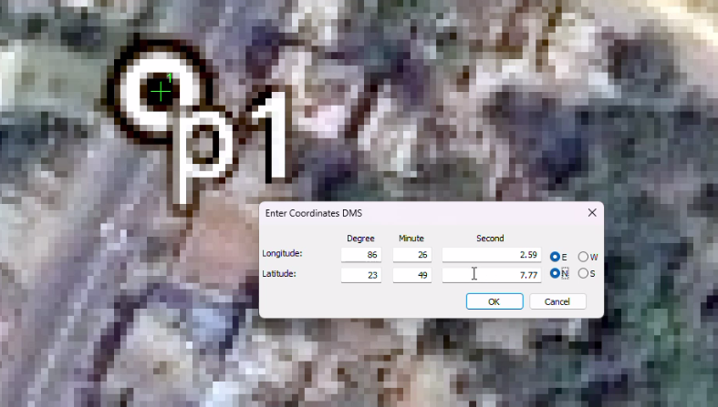
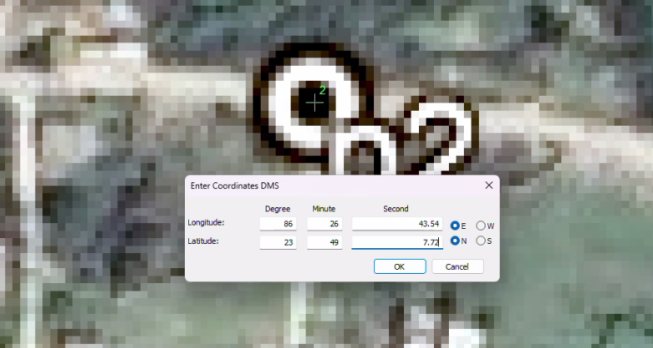
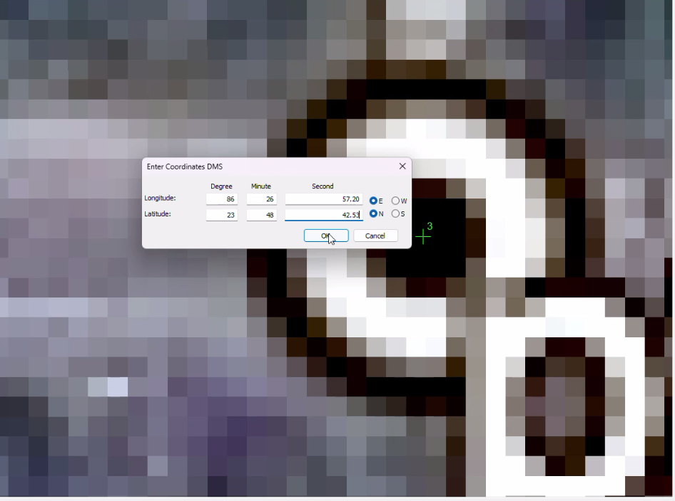
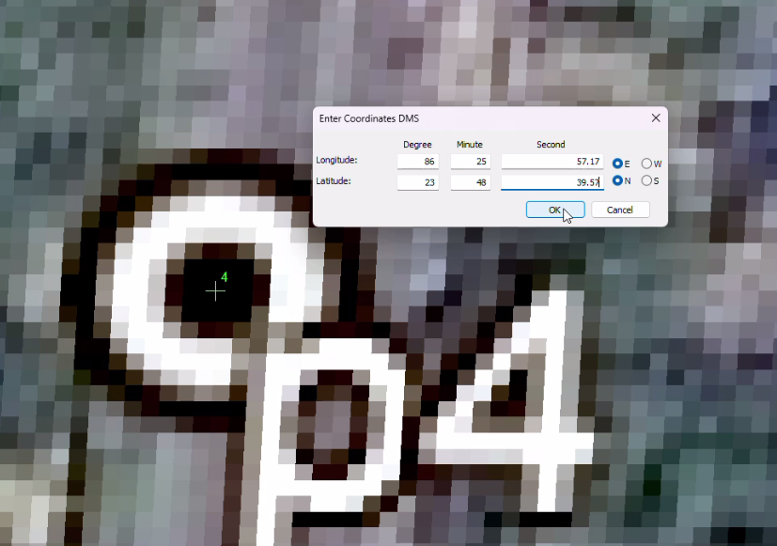
Step 2: zoom to point
first left click and then right click on it and Provide Co-ordinate in form of DMS(Degree Minutes Second), then ok
For DMS use data provided in above control Point table
Step 3: Do previous Step for Point 2, 3 and 4

Slide 10
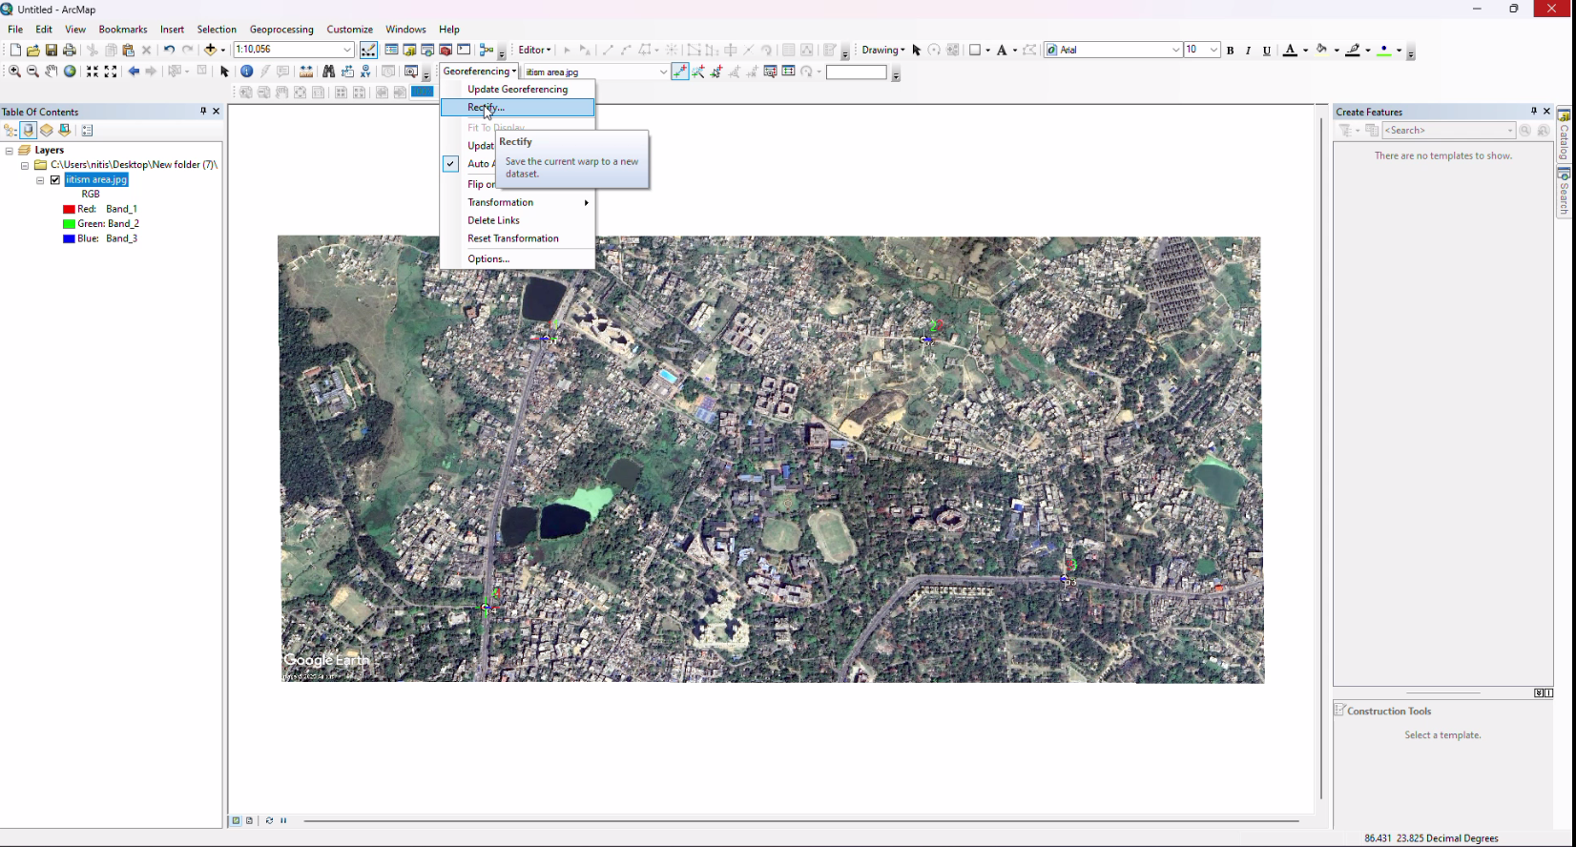
Step 3: Rectify
Use rectify tool to Save this coordinates to control point

Slide 11
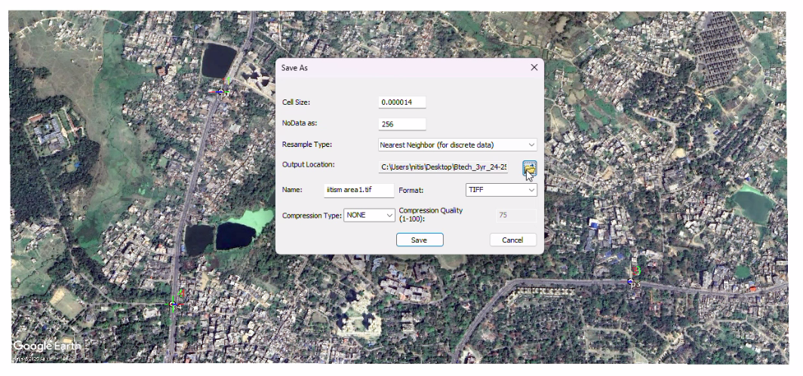
Step 4: Provide Name and location

Slide 12
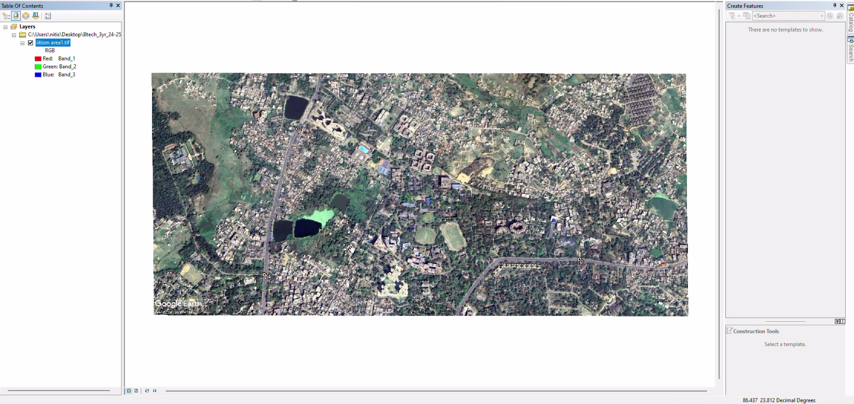
Output: Geo-referenced product

